Slide 1
Decision Dashboard for Urban Food Production
Weekly Progress Update — Week 5
Focus: Data Collection, Validation, and Preliminary Analysis
Chiranjeevi Venkata Shiva Ruthvik Savaram, Y247K345, 10/14/2026
Notes:
Good [morning/afternoon]. This is my Week 5 progress update. This week was about data collection, validation, and preliminary analysis — the goal is reliable tract-level data for the suitability analysis later. I'll also be upfront about a geography issue I found and what is still unresolved.

Slide 2
Tasks
Previous Week
This Week
Collected ACS candidate variables for the 516 KC metro tracts (2019 5-year) — Completed
Merged ACS with the health data; one-to-one merge validated — Completed
Cleaned the data; ran initial histograms and correlations — Completed
Confirm the final variable set — In Progress (carried forward; not yet finalized)
Created a preliminary map of the 516 project tracts from boundary data — Completed (preliminary)
Explored health indicators: descriptive statistics and correlations — Completed (preliminary)
Extracted USDA food-access data for the 14-county area (607 records) — Completed (preliminary); variable selection pending
Investigated census-tract geography differences between datasets — Issue identified; not yet resolved
Investigated public transit sources (KCATA GTFS, MARC ArcGIS service) — In Progress
Vacant-land / parcel data collection — Not Started
Decision Dashboard for Urban Food Production — Weekly Progress
2
Notes:
Last week I collected and merged the ACS data. This week I moved on to the other categories in the reference document. The map, health exploration, and USDA extraction are done at a preliminary level. The geography issue is identified but not resolved. Transit is in progress, and vacant land hasn't started. The final variable set is still not finalized.

Slide 3
Project Scope and Required Data
Study area: 14 counties (9 Missouri, 5 Kansas) — 516 census tracts. Required categories follow the professor's reference documents.
Category | Required variables (reference document) | Obtained so far | Status
Demographic & socioeconomic | Population density, % Black / Hispanic, foreign-born, disability, age 65+, no vehicle, households with children, renter-occupied, income, rent / home value, poverty, SNAP, employment, education | ACS 2019 candidates for 516 tracts (poverty, no vehicle, SNAP, income, foreign-born, Black, Hispanic/Latino, children, renter, rent, home value, education, 65+) | Partly collected
Health | Obesity, diabetes, high blood pressure | CDC PLACES 2023, 516 tracts | Collected
Food access | Distance to nearest food store | USDA Food Access Research Atlas: 607 records (2020 tract IDs) | Preliminary
Transit | Public transit access (ArcGIS-prepared) | KCATA GTFS audit; MARC service is a candidate only | Investigating
Vacant land | Vacant land availability (Kansas ORKA, KCMO Parcel Viewer) | Not yet collected | Pending
Some variables in the reference list are not yet in the candidate set (e.g., population density, disability, employment, below-high-school education).
Decision Dashboard for Urban Food Production — Weekly Progress
3
Notes:
The study area is 14 counties and 516 tracts. This table maps the professor's required categories to what I have. Health is collected. Socioeconomic is partly collected — I have a candidate set from ACS, but some variables on the reference list, like population density, disability, and employment, are not in it yet. Food access is preliminary, transit is being investigated, and vacant land hasn't been collected. Per the reference, data should be at census-tract level, with parcels associated to tracts.

Slide 4
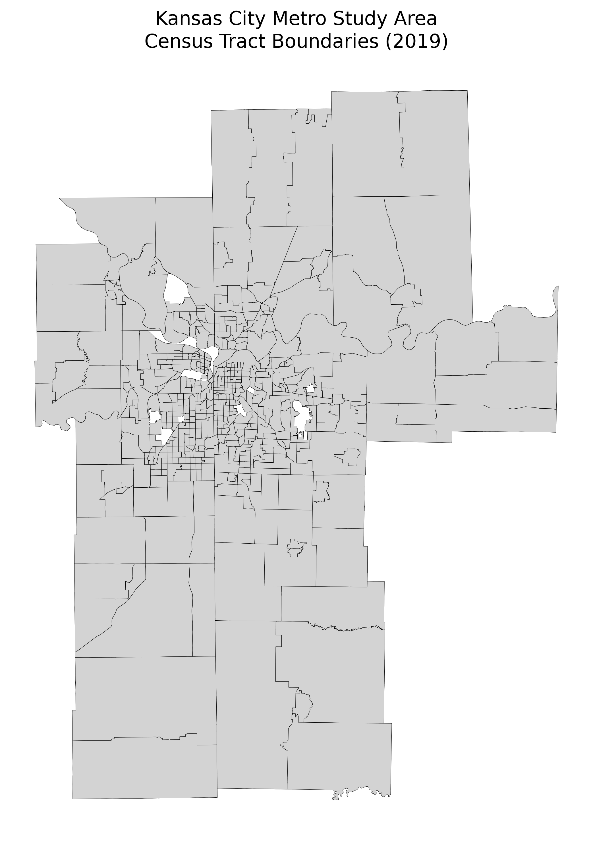
Data Collected and Preparation
Three tract-level sources and a preliminary map; geography is not yet harmonized
CDC PLACES 2023 (health)
2010-era tract IDs
516 rows × 81 columns, filtered to the 14 counties
ACS 2019 5-year (socioeconomic)
2010-era tract IDs
516 unique tract IDs, 0 unmatched, 0 duplicates. 2023 ACS matched only 430 of 516.
USDA Food Access Atlas (2025 version)
2020 tract IDs
607 records for the 14 counties; uses 2020 tract IDs.
Exact ID matches with project IDs: 430 of 516. 86 project IDs and 177 USDA IDs have no exact match.
Not yet harmonized: the project IDs match the 2010 tract relationship list, while USDA uses 2020 IDs. These datasets cannot be merged directly until the vintages are reconciled and documented.
Preliminary map: shows the study area and geographic data preparation only — not a suitability map, and no priority parcels are shown. The 516 project tract IDs matched the boundary dataset.
Source: CDC PLACES 2023; ACS 5-year estimates (U.S. Census Bureau); USDA ERS Food Access Research Atlas
Decision Dashboard for Urban Food Production — Weekly Progress
4
Notes:
Three sources so far. Health and ACS are done at 516 tracts; the ACS merge had zero unmatched and zero duplicates, but only when I used 2019 data — the 2023 ACS matched 430 of 516. The reason is a tract-geography vintage difference: my project IDs match the 2010 tract list. The USDA food-access file uses 2020 tract IDs, 607 records for the 14 counties, which is more than 516 because the tracts were redrawn. So I have not merged USDA with the rest and I'm not calling the data harmonized. The map is a preliminary map of the study area, not a suitability map.

Slide 5
Preliminary Health-Indicator Analysis
CDC PLACES crude prevalence across the 516 project tracts (study-area statistics, not national)
Mean prevalence (%) and standard deviation
Overlapping indicators (correlation)
Obesity
37.9% (SD 6.8)
Physical inactivity ↔ fair/poor health
0.956
High blood pressure
33.6% (SD 7.3)
Diabetes ↔ high blood pressure
0.949
Physical inactivity
25.1% (SD 9.2)
Diabetes ↔ fair/poor health
0.940
Fair or poor health
17.1% (SD 7.8)
Obesity ↔ fair/poor health
0.918
Diabetes
11.1% (SD 4.7)
Screening shows which indicators carry overlapping information.
Correlation does not show causation.
The final health-variable shortlist is still pending.
Obesity, diabetes, and high blood pressure are the reference document's health indicators; physical inactivity and fair/poor health were examined for overlap.
Source: CDC PLACES 2023 release, census-tract data; project calculations
Decision Dashboard for Urban Food Production — Weekly Progress
5
Notes:
Descriptive statistics across the 516 study-area tracts: obesity averages about 37.9 percent, high blood pressure 33.6, physical inactivity 25.1, fair or poor health 17.2, and diabetes 11.1. These are study-area numbers, not national. The correlation screening shows many indicators overlap: physical inactivity and fair or poor health at 0.956, diabetes and high blood pressure at 0.949. That means using several of them could count the same information more than once. This doesn't show one causes the other. I haven't decided the final health shortlist.

Slide 6
Socioeconomic and Demographic Analysis
Exploratory correlations among ACS 2019 candidate variables (516 tracts)
Median income ↔ Median home value
+0.88
Shows possible overlap between candidates, e.g., poverty and SNAP.
Poverty and no-vehicle households are promising candidates for review.
Exploratory only: not causal, not final weights.
Poverty ↔ SNAP
+0.86
Bachelor's+ ↔ Median home value
+0.85
Foreign-born ↔ Hispanic/Latino
+0.81
No vehicle ↔ SNAP
+0.78
Poverty ↔ No vehicle
+0.75
Poverty ↔ Median income
-0.72
Correlation coefficient (right of line = positive, left = negative)
Missing values (not treated as zero)
Percentage measures can also be missing where the denominator is zero. Variables have not been finalized.
1
tract: median household income
17
tracts: median rent
4
tracts: median home value
Source: ACS 2019 5-year estimates (U.S. Census Bureau); project calculations
Decision Dashboard for Urban Food Production — Weekly Progress
6
Notes:
Same ACS candidate set as last week, now with the correlations in context. Income and home value are at 0.88, poverty and SNAP at 0.86, bachelor's degree and home value at 0.85, foreign-born and Hispanic or Latino at 0.81. Poverty and households without a vehicle are 0.75, and poverty and income are negative 0.72. These help me see overlap between candidates. They are exploratory, not causal, and not weights. Missing values are few: one tract for income, 17 for rent, 4 for home value. I don't treat missing as zero. Variables aren't finalized.

Slide 7
Food Access and Transit Investigation
USDA food access (preliminary)
Public transit (in progress)
Tract-level workbook with straight-line and driving-distance measures
14-county extraction: 607 records (2020 tract IDs)
DD_SRAM_LA1and10 (low access, 1-mile urban / 10-mile rural driving): 603 non-missing, 4 missing; 262 tracts flagged 1
DD_SRAM_LILATracts_1And10 (low income and low access): 607 non-missing; 55 tracts flagged 1
Also examined: population-share measures at 1 mile and half mile (lapop1share, lapophalfshare)
KCATA GTFS feed audit
30 routes (29 bus, 1 streetcar) · 2,300 stops · 5,617 trips · 197,874 stop-time records · 2,275 stops inside project tracts · 171 of 516 tracts contain at least one stop
This feed does not appear to cover the whole 14-county area. A tract with no stop is not automatically a tract with no transit access.
Candidate regional source (not validated)
MARC / ConnectedKC 2050 ArcGIS service, layer 12 “TransitAccess”, field AccessLevelDesc (Low / Moderate / High). Coverage, methodology, and fit with the requested transit variable still to be checked.
Variable definitions and intended use still need review. These are candidates, not final criteria.
Source: USDA ERS Food Access Research Atlas; KCATA GTFS feed; MARC RTP2050 MapServer (gis2.marc2.org)
Decision Dashboard for Urban Food Production — Weekly Progress
7
Notes:
Two investigations. First, the USDA food-access data: 607 records in my 14 counties, with 2020 tract IDs. Two flags I looked at: low access at one mile urban and ten miles rural, 262 tracts flagged out of 603 non-missing; and the low-income and low-access flag, 55 tracts. I still need to review the definitions before choosing variables. Second, transit: the reference document names public transit access as a required category, prepared through ArcGIS, but I don't have a specific verified layer. As an initial exploration I audited the KCATA GTFS feed: 30 routes, 2,300 stops, 171 of my 516 tracts contain a stop. But the feed doesn't cover the whole metro area, so I can't call a tract with no stop 'no transit.' I also found a possible regional service from MARC with a TransitAccess layer. It's only a candidate — I haven't validated its coverage or method, and I'm not claiming it's the professor's source.

Slide 8
Data Validation and Current Challenges
Status of each data-preparation step
Health-data preparation
Completed
For the current 516-tract project dataset
Health / socioeconomic exploratory analysis
Preliminary
Descriptive statistics and correlations done; no variables finalized
USDA food-access extraction
Preliminary
607 records extracted; variable selection pending
Census-tract geography harmonization
Unresolved
Project IDs use 2010-era tracts; USDA uses 2020 IDs. Exact ID matches: 430. 86 project IDs and 177 USDA IDs have no exact match. Reconciliation is required before merging.
Transit source validation
In progress
GTFS covers only part of the area; MARC layer unvalidated
Vacant-land / parcel collection
Pending
Kansas ORKA and KCMO Parcel Viewer
Final suitability scoring and dashboard
Future work
After data collection and validation
“Completed” refers to the step named, not to overall data integration, which is not finished.
Decision Dashboard for Urban Food Production — Weekly Progress
8
Notes:
Honest status. Health data preparation is complete for the current project dataset. Exploratory analysis is preliminary. USDA extraction is preliminary. The geography harmonization is unresolved, and that is the biggest issue because it affects whether datasets can be combined. Transit validation is in progress. Vacant land hasn't been collected. Suitability scoring and the dashboard are future work. 'Completed' means that step only — the overall data integration isn't finished.

Slide 9
Next Week Plans (10/21/2026)
Activities/Tasks
Verify the correct census-tract geography and document how 2010 and 2020 tract IDs will be reconciled
Validate the regional transit-access source and its methodology
Collect and inspect vacant-land / parcel data from Kansas ORKA and the KCMO Parcel Viewer
Finalize a defensible variable shortlist, accounting for redundancy and missing values
Build a data inventory: source, year, geography, variable definition, validation status
Expected Outcomes
A documented approach for reconciling census-tract vintages
A decision on whether the transit source can be used
A first look at vacant-land / parcel data and its coverage
Deliverable
Data inventory, documented geography approach, variable shortlist, and progress presentation
Decision Dashboard for Urban Food Production — Weekly Progress
9
Notes:
Next week's priority is the geography issue, because it decides how the datasets can be combined. Then validating the transit source, collecting vacant-land and parcel data, finalizing a defensible variable shortlist, and building a data inventory. AHP, suitability scoring, and the dashboard come after the data is collected and validated; none of those have started.

Slide 10
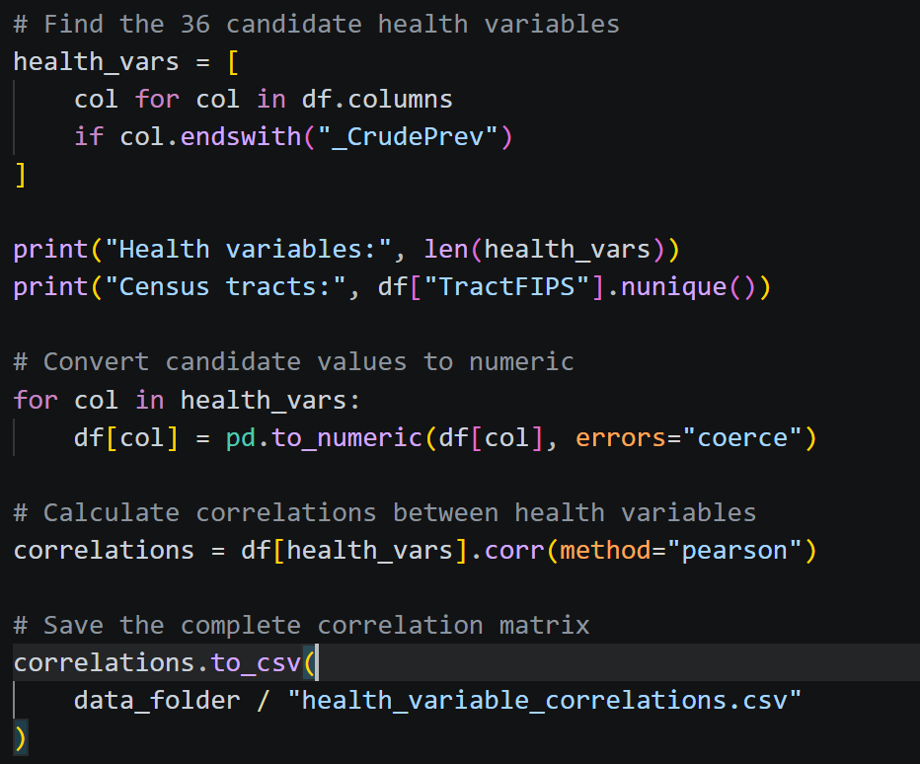
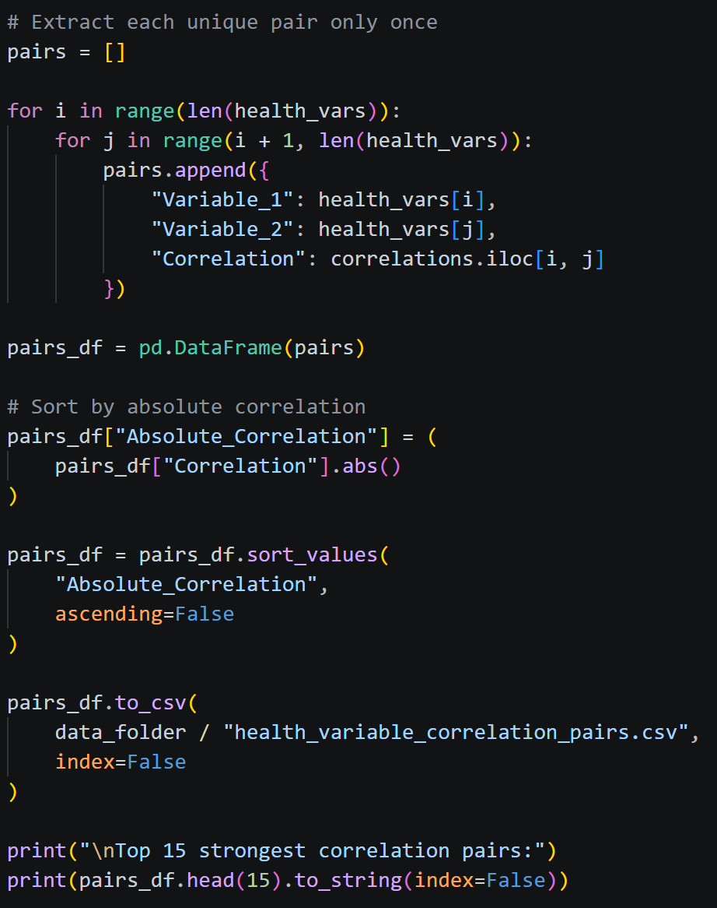
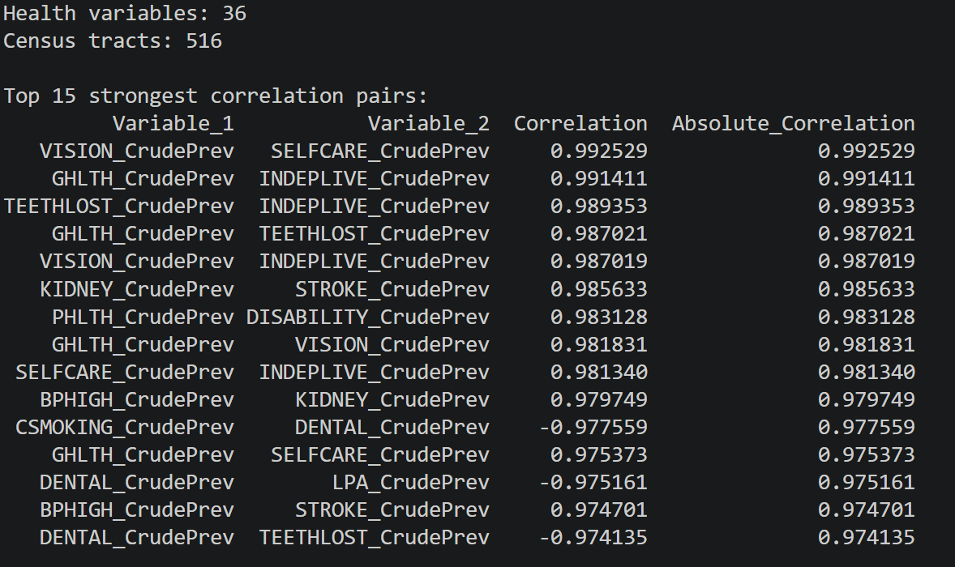
Appendix — Code and Outputs
Decision Dashboard for Urban Food Production — Weekly Progress
10
Notes:
Slide 10 shows the health correlation code and output. Slide 11 shows the socioeconomic correlation code and output. Slide 12 shows the USDA geography audit and its results.

Slide 11
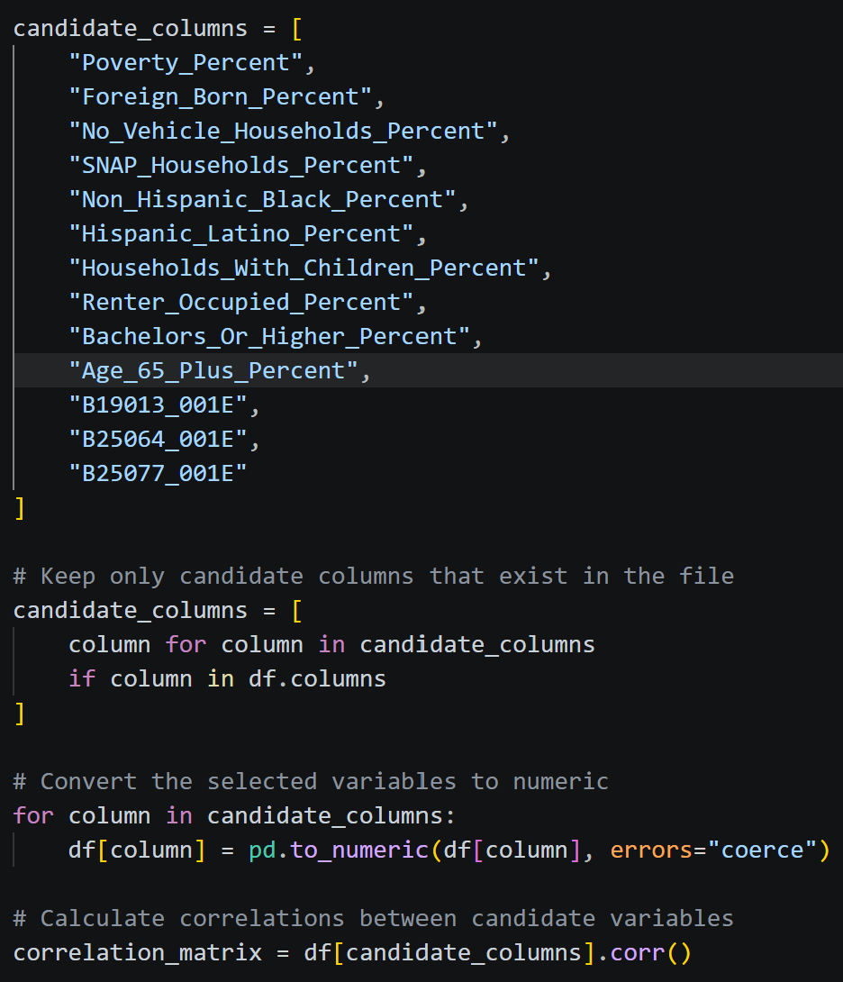
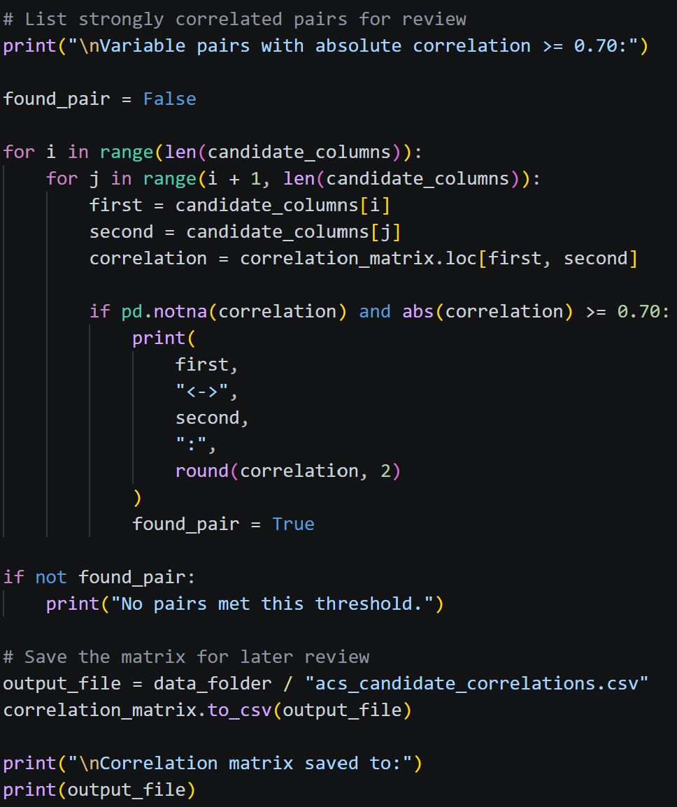
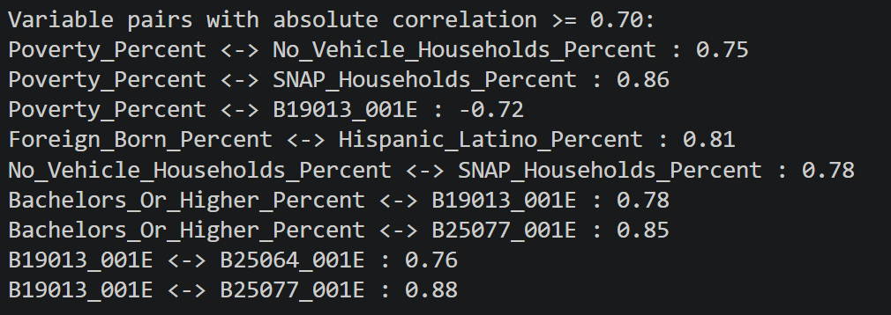
Appendix — Code and Outputs

Slide 12
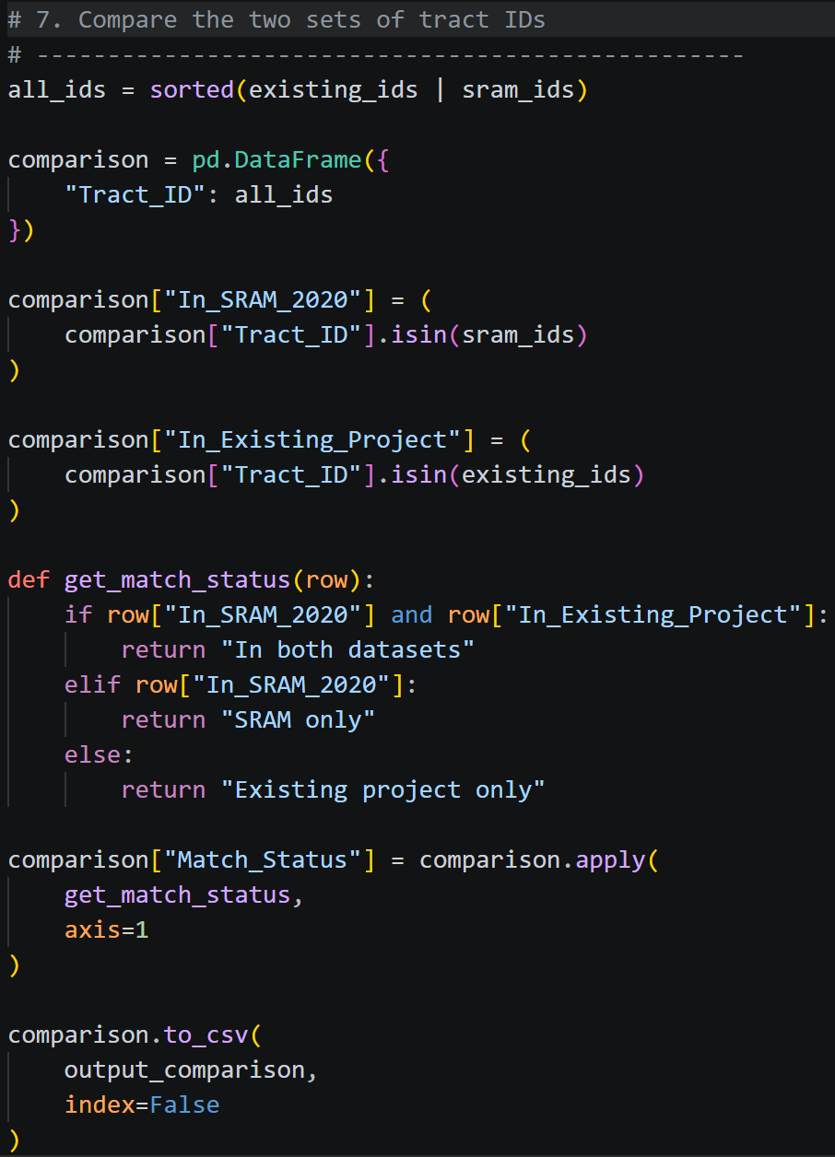
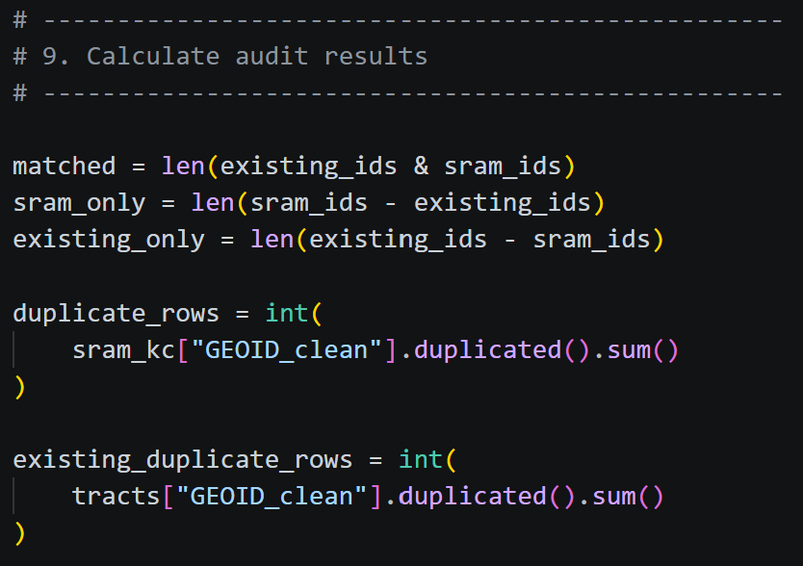
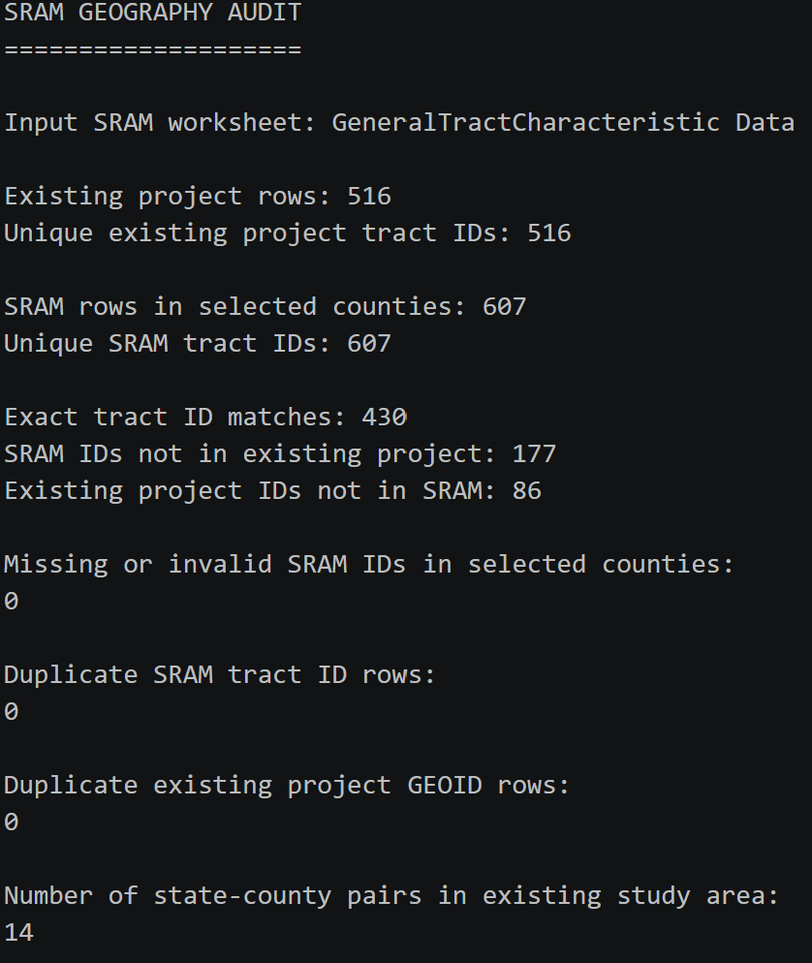
Appendix — Code and Outputs

